Slide 1
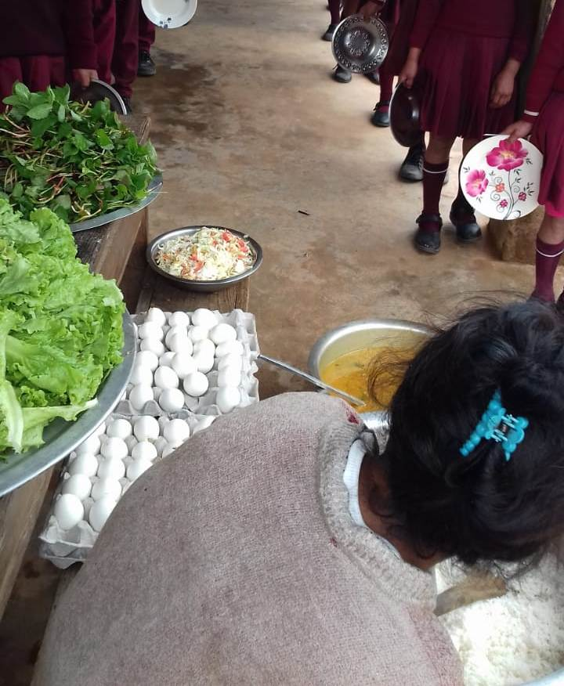
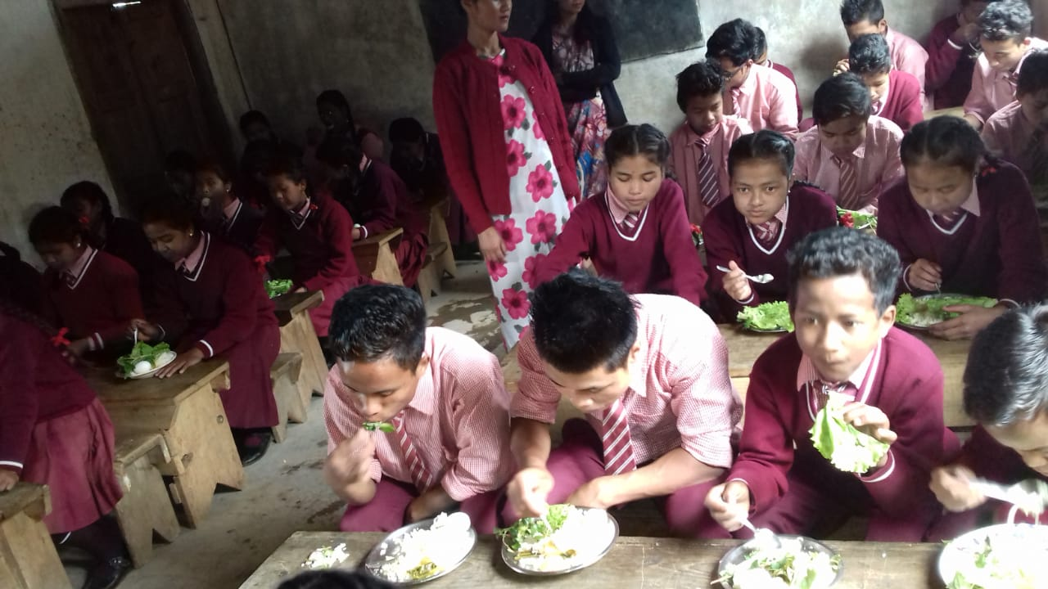
MID DAY MEAL SCHEME MEGHALAYA
Annual Work Plan & Budget
2019-20
Notes:
1

Slide 2
Good Practices
The State Government has established a Corpus Fund amounting to Rs. 10 crores to avoid any delay in releasing of funds to school.
E-Transfer of Mid Day Meal Funds such as Conversion cost and honorarium of Cook-cum-Helpers directly from the State Level to the School’s bank account and Cook-cum-Helper’s personal account respectively.
Community Participations: In some Schools, Parents and community contribute vegetables, fruits, firewood etc. to schools for cooking of meals for the children.
Uses of Tiffin box is still being practiced in some Government Schools and others schools have been instructed to follow this practice. (Video: Patraga SSA UPS, West Garo Hills)
Kitchen Garden – Kitchen Garden is being practiced in schools where land is available. (Video: Mawpharkhrew RCLP & UP School, Mawkyrwat)
A Handbook on Mid Day Meal have been developed and have been distributed to all the State, Districts, Sub-Divisional & Block officials. The Same also has been distributed to 11803 Schools.
Wide Publicity through BIG FM 98.3 Radio on Mid Day Meal Scheme.

Slide 3
Initiatives Taken
MDM fund to the school is being done through E-transfer directly from the Directorate to the Districts/Sub-Divisional/Bank Account of the Schools and to the Personal Bank Account of the Cook-cum-helpers.
Corpus fund of Rs.10 crore is maintained and used as and when fund is awaited from Government of India. (Corpus fund of Rs.10 Cr is available)
100% Payment to FCI.
During 2018-19, fund has been released to the Districts/Schools/ Cook-cum-helpers upto the month of March 2019.
100% Payment of Transportation Assistance.
Coverage of 102% of School Health Programme in 2018-19.
1192 School have been replaced with Kitchen devices.

Slide 4
Contd….
Social audit : A meeting was held with Meghalaya Society For Social Audit & Transparency (MSSAT) Meghalaya, Shillong in their office on the 22nd March 2019 to carry out social audit on the implementation of Mid Day Meal Scheme during 2018-19 in two low performing districts chosen by MHRD & State i.e Ri-Bhoi and West Jaintia Hills respectively. The social audit for all the schools in these two districts will start from the month of May 2019.
Training of Cook-cum-helpers : Training of 4500 Cook-cum-Helpers in 11 Districts is during 2018-19.

Slide 5
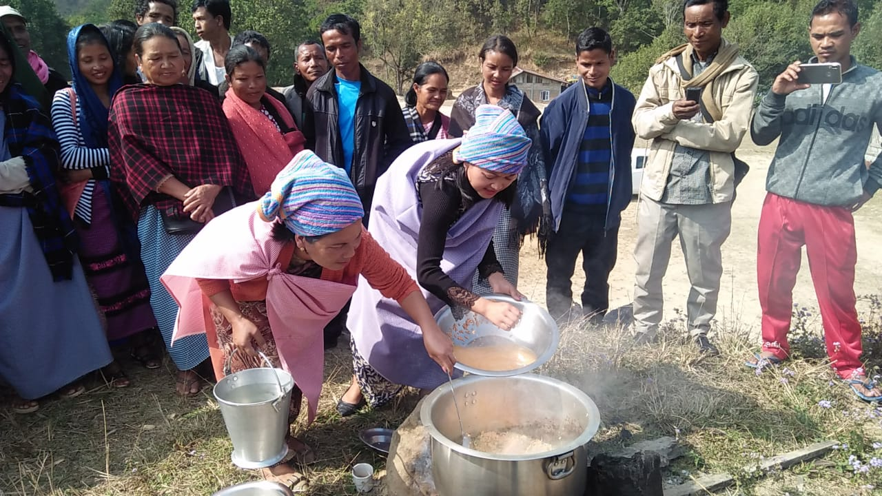
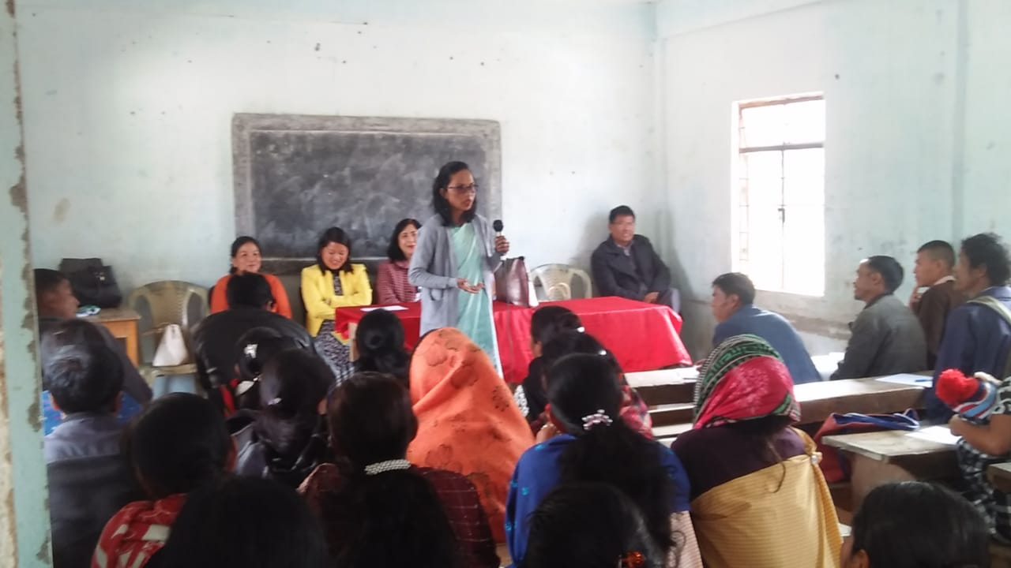
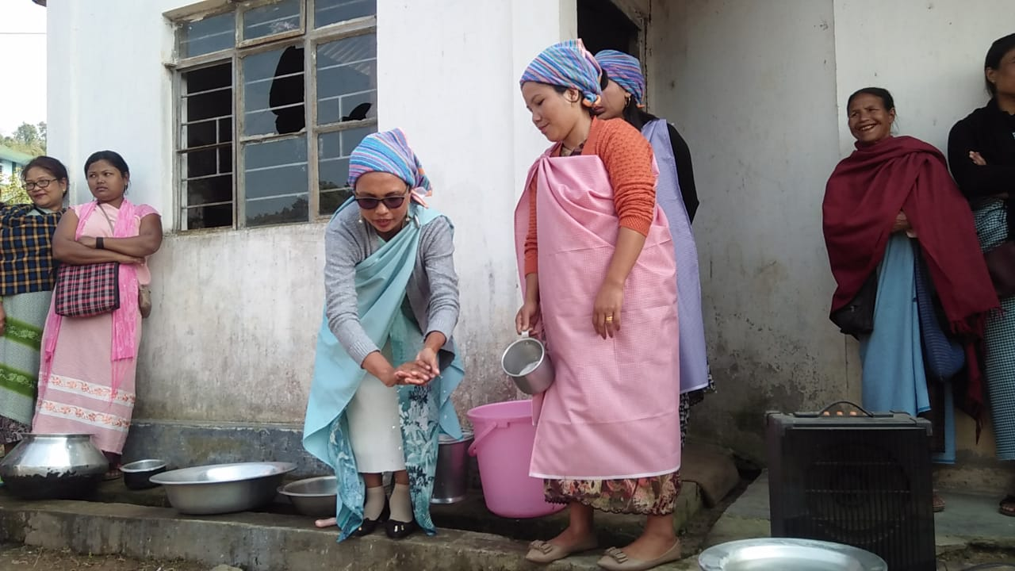
Training Gallery

Slide 6
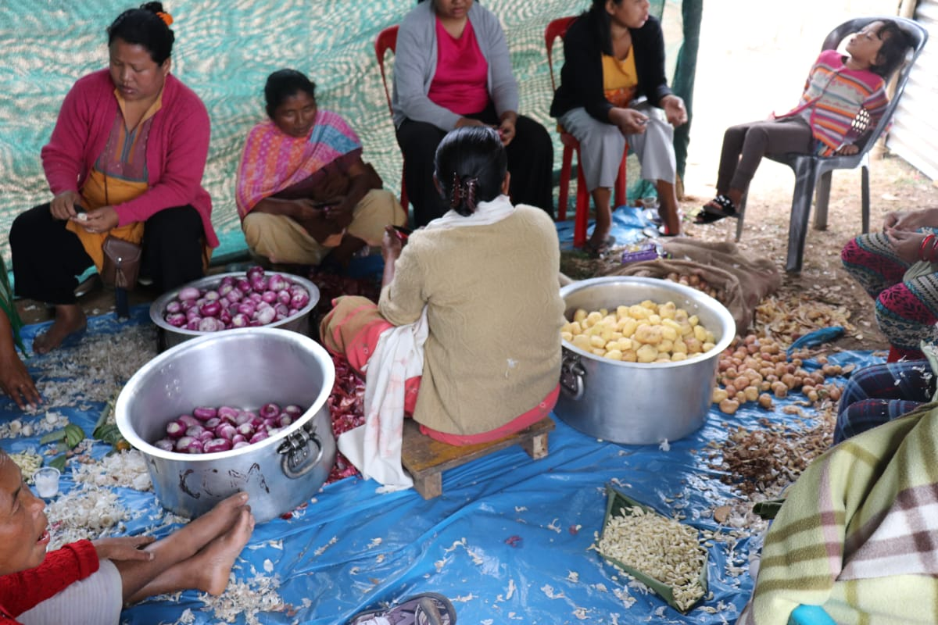
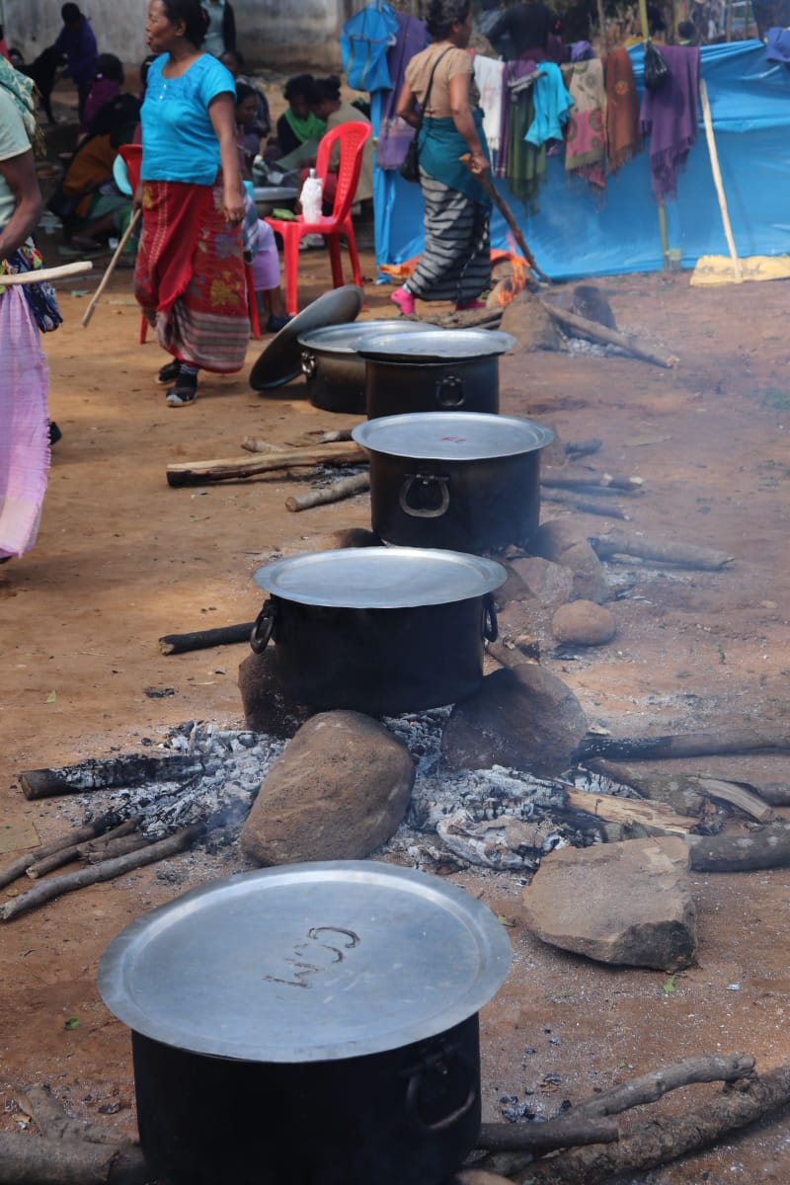

Slide 7
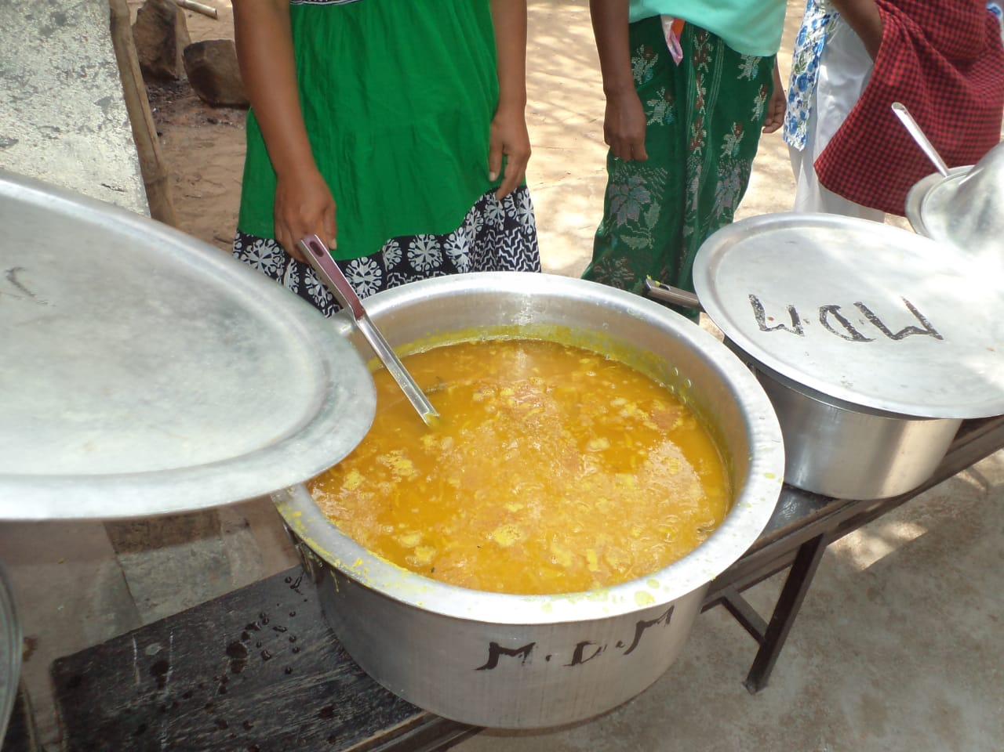
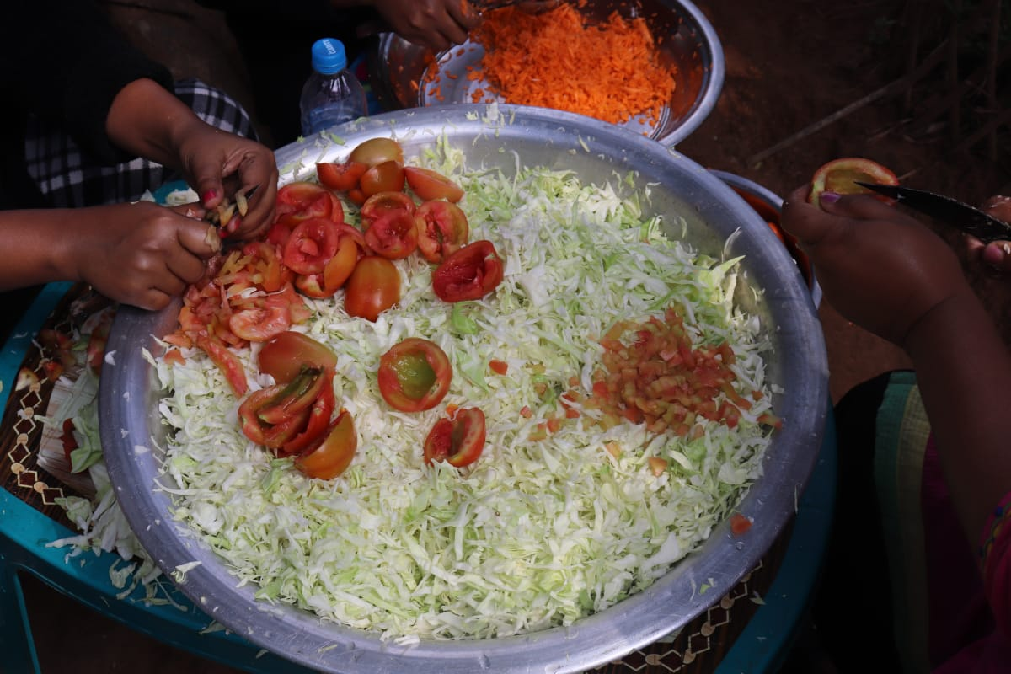
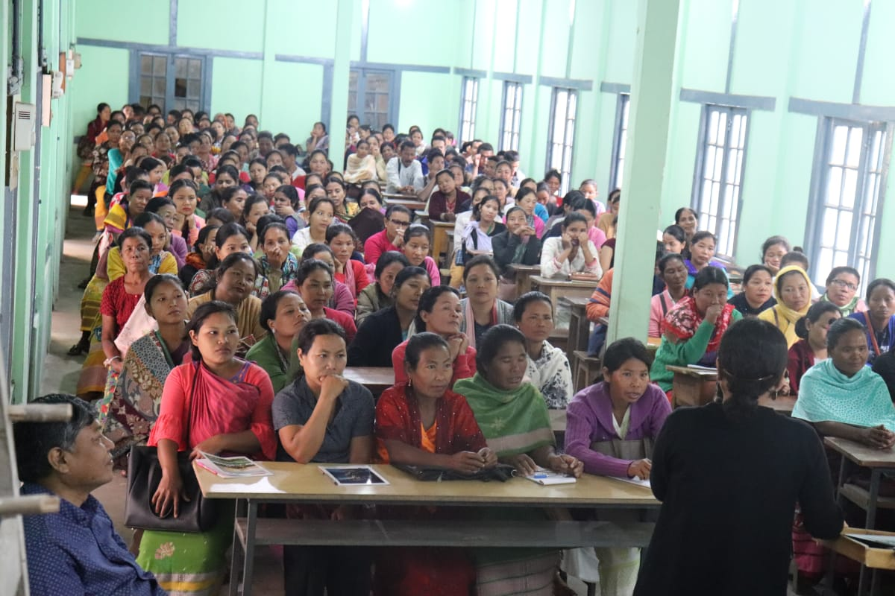

Slide 8
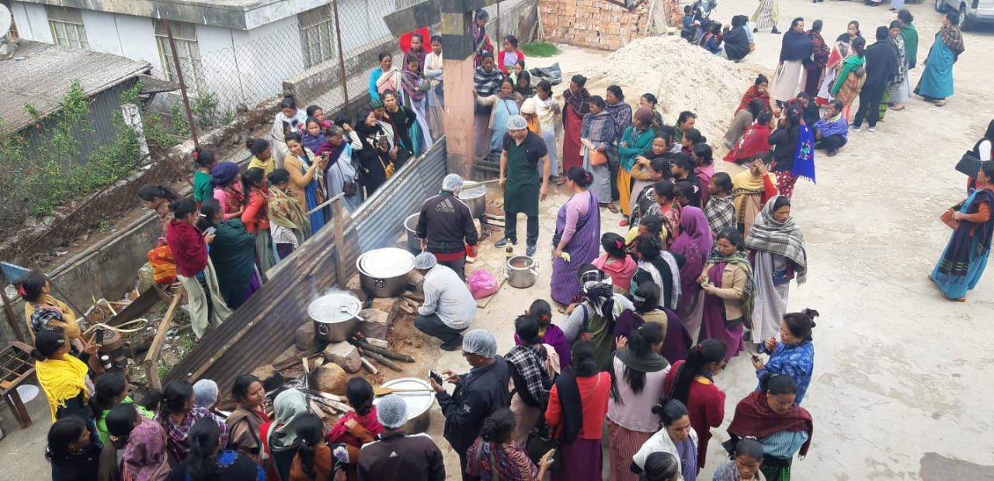
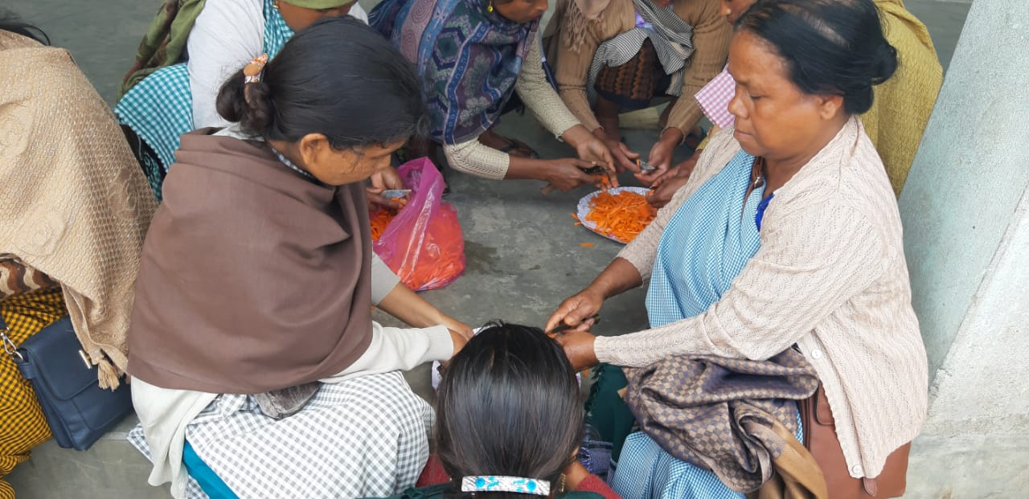

Slide 9
State Issues
Enhancement of honorarium to cook-cum-helpers from Rs.1000/- per month to Rs.3000/- per month.
Shortage of LPG.

Slide 10
Performance During 2018-19

Slide 12
Physical Achievement 2018-19
1.Number of Schools
Category | Total No. of existing Institutions | Coverage | % Vs. Institution
Pry | 8436 | 8312 | 98.53%
U.Pry | 3414 | 3403 | 99.68%
Total | 11850 | 11715 | 98.86%
2. Number of Children
Component | Enrolment as on 30.9.2019 | PAB Approval 2018-19 | Average no. of Children Covered | % Coverage Vrs PAB | % Coverage Vrs Enrolment
Children (Pry) | 426306 | 384583 | 383186 | 99.64% | 89.89%
Children (U.Pry) | 178277 | 142408 | 142647 | 100.17% | 80.01%
Total Children | 604583 | 526991 | 525833 | 99.78% | 86.97%

Slide 13
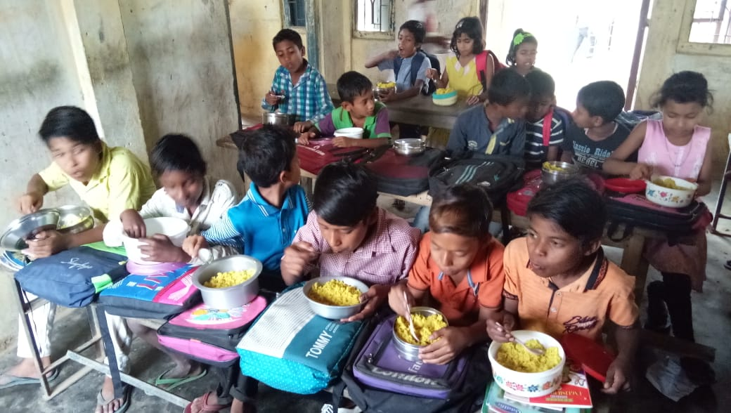
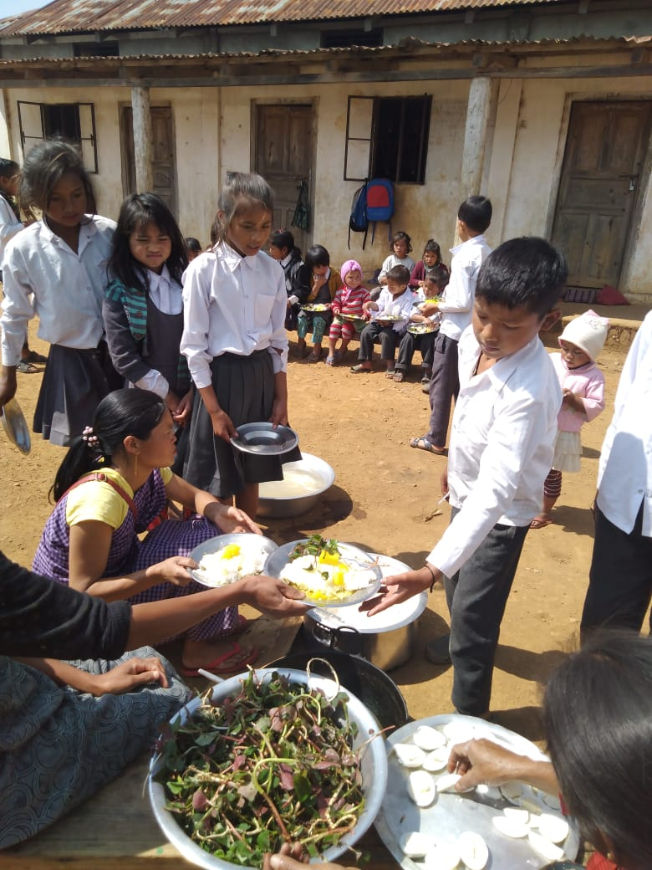
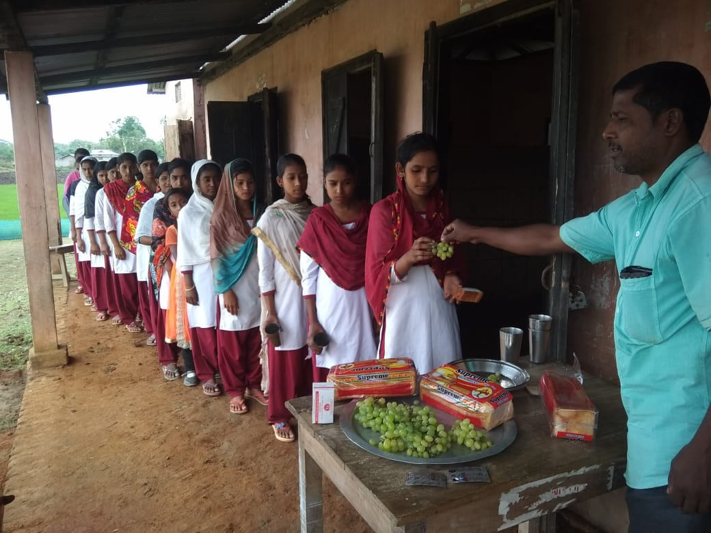
Patraga Primary School
West Garo Hills
Nongkasen Govt. Primary School
West Khasi Hills
Puskurnipara SSA Up. Primary School
West Khasi Hills

Slide 14
Contd..
3. Cook-Cum-Helpers
Stage | CCH PAB Approval | No. of cooks appointed | Gap Due to frequent Change of CCH | %
2 | 3 | 4 | 5 | 6
Primary | 13766 | 13214 | 552 | 95.99%
U Primary | 4781 | 4779 | 2 | 99.96%
Total | 18547 | 17993 | 554 | 97.01%
4. Foodgrain (In MTs)
Allocation | OB | Lifting | Consumed | Balance | %
12391.12 | 383.12 | 12285.60 | 12299.80 | 368.89 | 99.26%

Slide 15
Contd..
5. Construction of Kitchen Sheds
Years | Target (Units Sanctioned) | Constructed | In Progress | Not Started
2006-07 to 2011-12 | 9491 | 9491 | 0 | 0
2018-19 | 267 | 0 | 0 | 267
NB: Sanction of 267 unit of Kitchen shed have been received during the fag end of March 2019, and hence fund could not be utilised during 2018-19
6. Procurement of Kitchen Devices
Years | Target (Units Sanctioned) | Procured | In Progress | Not yet procured
2 | 3 | 4 | 5 | 6
2007-2019 (New) | 12089 | 12089 | 0 | 0
2011-2019 (Replacement) | 10074 | 10074 | 0 | 0

Slide 16
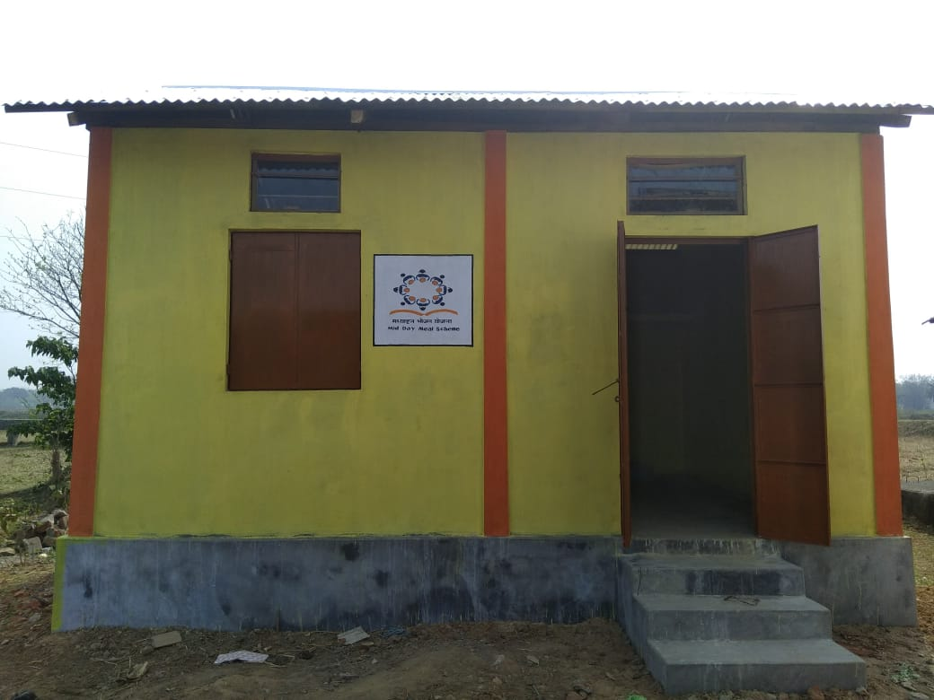
Bhairagupi SSA Primary School - South West Garo Hills
Kitchen shed under Plinth Area

Slide 17
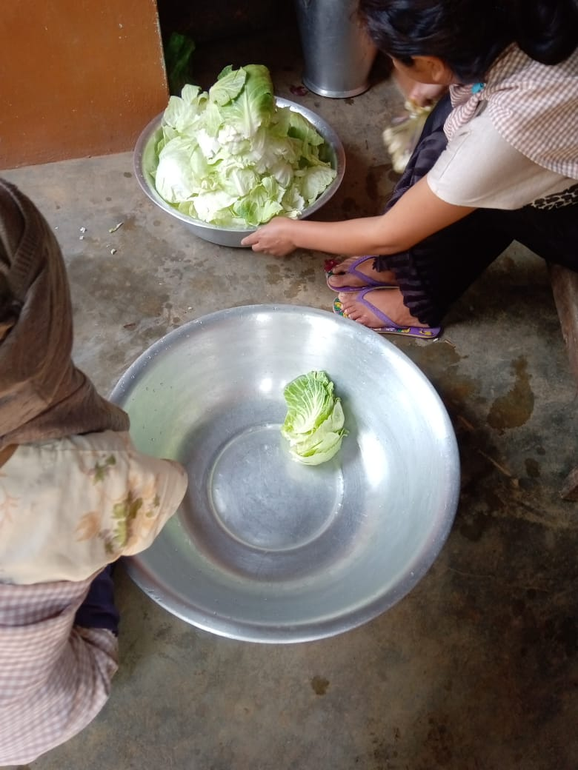
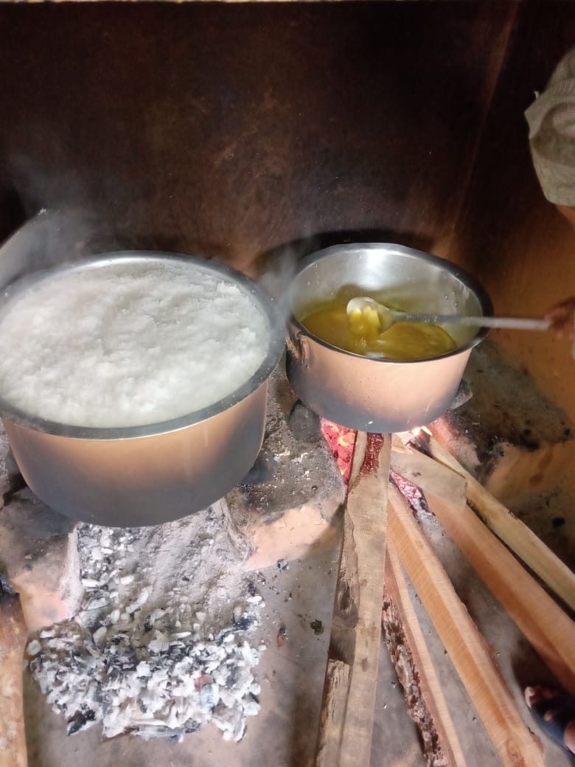

Slide 18
6. School Health Programme (SHP)
Year | Total children to be covered under SHP | Total children covered under SHP | % Coverage
2018-19 | 526991 | 540599 | 102%
Year | Weekly Iron & Folic Acid Supplementation (WIFS) | Deworming tablets distributed | Distribution of spectacles
2018-19 | 709712 | 994143 | 2497

Slide 19
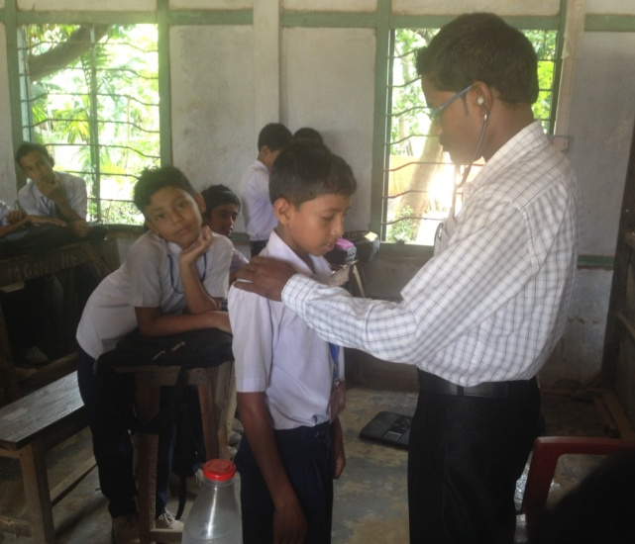
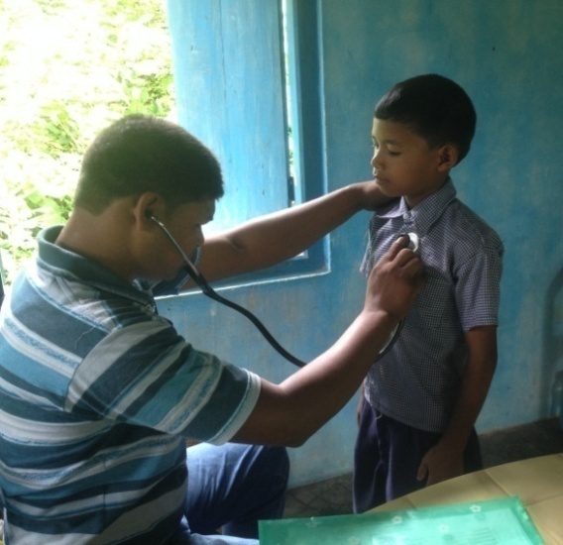
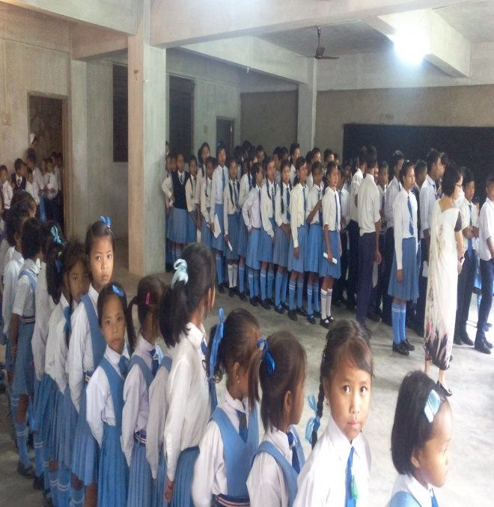
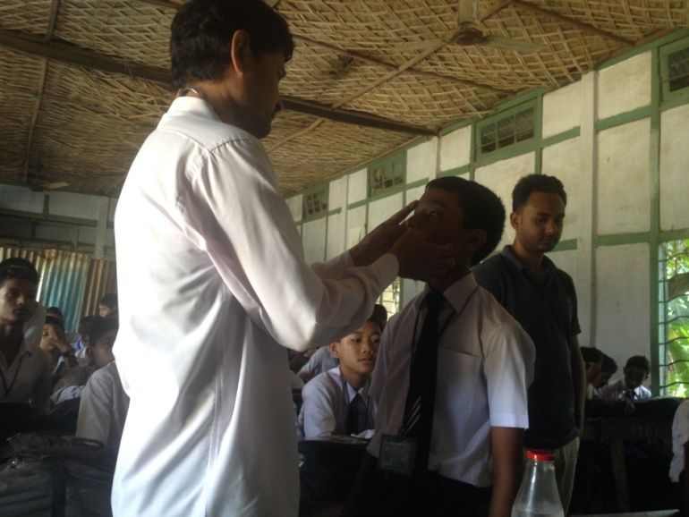
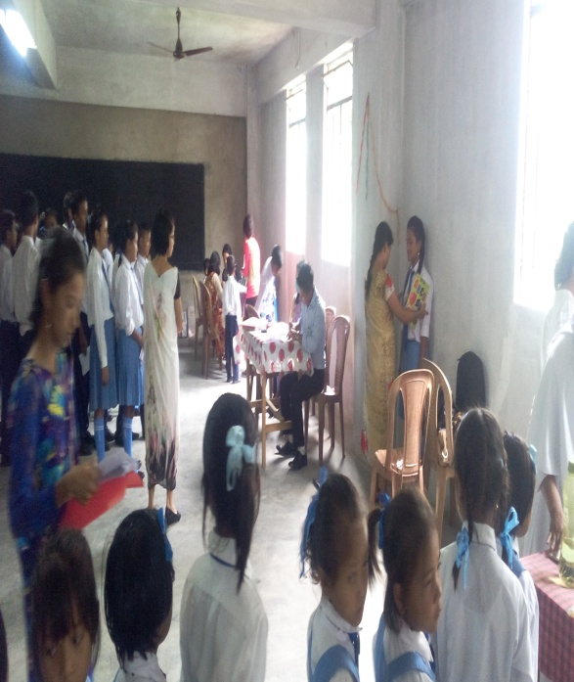
Health Screening of school students
Ri-Bhoi
and
West Garo Hills District

Slide 20
PAB Budget Approval-2018-19
Rs. In Lakhs
Component | 2018-19
 | Central | State | Total
A. Recurring Central Assistance
Cost of Foodgrain | 371.73 | 0.00 | 371.73
Conversion Cost | 4843.36 | 542.08 | 5385.44
Transportation Assistance | 1669.23 | 185.47 | 1854.70
Honorarium to cooks | 121.43 | 0.00 | 121.43
MME | 126.10 | 0.00 | 126.10
A. Total | 7131.85 | 727.55 | 7859.40
A. Non-Recurring Central Assistance
Kitchen Sheds | 0.00 | 0.00 | 0.00
Kitchen Devices | 3.35 | 0.00 | 3.35
B. Total | 3.35 | 0.00 | 3.35
G. Total (A+B) | 7135.20 | 727.55 | 7862.75

Slide 21
Fund Received during 2018-19 from Central & State Government
2018-19
Particulars | Amount (In Lakhs) |  |  | Date of Releasing
 | Central | State Share | Total | Central | State
A. Recurring Funds
Adhoc Installment | 1591.21 | 160.97 | 1752.18 | 1.5.2018 | 1.5.2018
Balance of 1st Installment | 2420.79 | 245.18 | 2665.97 | 24.8.2018 | 24.8.2018
2nd Installment | 2993.19 | 305.46 | 3298.65 | 27.12.2018 | 27.12.2018
B. Non-Recurring Funds
Kitchen Devices | 59.60 | 0.00 | 59.60 | 24.5.2018 | 9.7.2018
Kitchen Sheds | 669.59 | 74.41 | 744.00 | 27.3.2019 | 30.3.2019
Total (A+B) | 7734.38 | 786.02 | 8520.40
Kitchen Devices sanction is of 2017-18.
Kitchen Sheds sanction is of 2014-15.

Slide 22
Financial Target Vs. Achievement of (Amount in Lakhs)
Component | Budget Provision |  |  | Financial Expenditure |  |  | % of Utilisation | Unspent Balance
 | Central | State | Total | Central | State | Total
A) Recurring Assistance
Cost of Foodgrain | 371.73 | 0.00 | 371.73 | 368.57 | 0.00 | 368.57 | 99.15% | 3.16
Conversion Cost | 4843.36 | 542.08 | 5385.44 | 4828.88 | 540.49 | 5369.37 | 99.70% | 16.07
Honorarium to cooks | 1669.23 | 185.47 | 1854.70 | 1611.89 | 179.10 | 1790.99 | 96.56% | 63.71
Transportation Assistance | 121.43 | 0.00 | 121.43 | 125.20 | 0.00 | 125.20 | 103.10% | -3.77
MME | 126.10 | 0.00 | 126.10 | 125.70 | 0.00 | 125.70 | 99.68% | 0.40
Total | 7131.85 | 727.55 | 7859.40 | 7060.24 | 719.59 | 7779.83 | 98.99% | 79.57
B. Non-Recurring Central Assistance
Kitchen Sheds | 669.59 | 74.41 | 744.00 | 0.00 | 0.00 | 0.00 | 0.00% | 744.00
Kitchen Devices | 59.60 | 0.00 | 59.60 | 59.60 | 0.00 | 59.60 | 100.00% | 0.00
B. Total | 729.19 | 74.41 | 803.60 | 59.60 | 0.00 | 59.60 | 7.42% | 744.00
G. Total (A+B) | 7861.04 | 801.96 | 8663.00 | 7119.84 | 719.59 | 7839.43 | 90.49% | 823.57

Slide 23
Proposal for 2019-20

Slide 24
Propose Institutions 2019-20
Sl. No. | Category | Existing No. of Schools | New Schools | Total of Schools Proposed to be Covered in 2019-20
1 | Primary | 8379 | 0 | 8379
2 | Upper Primary | 3407 | 17 | 3424
 | Total | 11786 | 17 | 11803

Slide 25
Physical Targets for 2019-20
S. No | Component | Proposal for 2019-20
1 | Children (Pry) | 385399
2 | Children (U Pry) | 148353
Total Children |  | 533752
3 | Working Days (Primary & Up.Pry) | 200-Pry
 |  | 220-U.Pry
4 | Cook cum Helpers | 18547
5 | Kitchen cum Store | NIL
6 | New Kitchen Devices | 84 (New)
7 | Kitchen Devices replacement | 538
8 | Kitchen Shed Repairs | 3390
Proposal for New kitchen Devices is for 16 New Government Schools and 67 New Schools which has already been approved by PAB 2018-19.
Notes:
25

Slide 26
Financial Requirements for 2019-20
Rs. In Lakhs
Recurring Central and State Assistance
Components |  | Central | State | Total
Recurring Asssitance
1 | Cost of Foodgrain | 378.11 | 0.00 | 378.11
2 | Cooking Cost | 4926.39 | 551.30 | 5477.68
3 | Honorarium to Cook-cum-Helper | 1669.23 | 95.62 | 1764.85
4 | Transportation Assistance | 243.25 | 0.00 | 243.25
5 | MME | 194.86 | 0.00 | 194.86
Non Recurring Assistance
6 | Kitchen-cum-Store | 0.00 | 0.00 | 0.00
7 | Kitchen Devices (New) | 10.08 | 1.12 | 11.20
8 | Kitchen Devices (Replacement) | 48.42 | 5.38 | 53.80
9 | Repair of kitchen-cum-stores | 305.10 | 33.90 | 339.00
Total |  | 7775.43 | 687.32 | 8462.75

Slide 27
Action Taken Report By State On the PAB Commitment 2018-19

Slide 28
S.No. | Commitment | Action Taken
1. | Coverage of children : Commitment: State Government to take necessary steps to check the drop-in coverage especially in Ri Bhoi District | Steps have been taken to reduce the drop-in coverage of students in Ri Bhoi District. As such, the percentage of increase as of date is 81% compared to 69% of last year i.e. 2018-19 in Upper Primary stage.
2. | Kitchen cum store : Commitment: State Government to complete construction of 120 kitchen sheds which is in progress. | All the 120 kitchen sheds which is in progress have been completed. Regarding proposals for repairs of the old kitchen sheds, the same is included in the AWP & B 2019-20.

Slide 29
S.No | Commitment | Action Taken
3. | Testing of food samples : Commitment : The State Government informed that Pasteur Institute, Shillong has been identified for testing of food samples and from June 2018 testing of food will be done. | Testing of food samples by the Pasteur Institute, Shillong could not be taken up during the month of June 2018 as informed by the Pasteur Institute vide letter No. CFSM/FSSA/2011/Imple/1/Pt.1/272, Dated 23.03.19 that the renovation/upgradation work of Chemical Section of the Laboratory is expected to be completed by the end of April 2019 and the installation of Equipments is expected to be completed by May-June 2019. After completion of the work, the testing of food samples will be taken up.

Slide 30
S.No. | Commitment | Action Taken
4. | Social Audit : Commitment : Social Audit will be conducted as per MHRD, MDM Guidelines and Reports be shared with MHRD. | The Meghalaya Society of Social Audit & Transparency (MSSAT) has been selected as an agency to conduct Social Audit for Mid Day Meal Scheme. During 2019-20, Social Audit will be taken up in the two low performing districts, i.e. Ri Bhoi and West Jaintia Hills District during the month of May 2019 and Reports of the same will be submitted to MHRD.

Slide 31
S.No. | Commitment | Action Taken
5. | Rashtriya Bal Swasthya Karyakram (RBSK) : Commitment : State Government informed that efforts will be made to utilize medical staff under Ayush Department and get all children screened for medical checkup. | Under the RBSK Programme, NHM contractual Ayush MOs are engaged in the screening of children at the schools. The Teams are base at the blocks and they visited schools once a year for screening as per the operational guideline. Till dated there is no vacancy of Ayush MOs in the team. The screening performances are increased over the year and many children having Birth defects and Developmental Delays such as (Cleftlip/Palate, Congenital Heart Disease, foot club etc) are treated through the RBSK programme.

Slide 32
S.No. | Commitment | Action Taken
6. | Provision of safe drinking water : Commitment : Use of new innovative projects formulated by taking inputs from State Council of Science, Technology & Environment, Meghalaya and Public Health Engineeing Department. | A Proposal for New Innovative Project have been submitted to Ministry of HRD, Department of School Education& Literacy, Government of India vide letter No.EDN.351/2009/248, Dated:19.7.2017 but sanction is yet to receive.
7. | Meeting of District level Steering –cum-Monitoring Committee : Commitment : State Govt. assured to take necessary steps that meeting of district level are held regularly. | During the year 2018-19, 36 meetings of the District Level Steering -cum- Monitoring Committee were held.

Slide 33
S.No. | Commitment | Action Taken
8. | Data entry on MIS Portal : Commitment: Necessary action to be taken by the State | Instructions were issued to all the districts/sub-division offices that there should not be a mismatch of data in the AWP & B and the data entered in the MIS Web Portal.
9. | Automated Monitoring System (AMS) : Commitment : State Government assured to make efforts to roll out the data of all the districts in ARMS Portal | In some districts, the data has been sent to ARMS Portal while others will be sending as soon as training on ARMS is completed. Steps have been taken and 54.89% schools have been registered in the ARMS Portal. In 2018-19, some districts have already started reporting data to the ARMS Portal. Training to teachers have already started. Training have already been conducted in East Khasi Hills, West Jaintia, West Khasi Hills, South West Garo Hills

Slide 34
S.No. | Commitment | Action Taken
10. | Ayushman Bharat | Efforts will be made to co-ordinate with the concerned department.
11. | Kitchen Garden : | All schools have been encouraged for setting up of kitchen gardens depending on availability of land in the school.

Slide 35
THANK YOU

